Slide 1

Are We Using the Right Fraud Threshold?
Presented by
Helen Corbat M.S. Data Science — University of Virginia B.S. Chemical Engineering — Purdue University
A Data-Driven Approach to Threshold Optimization
Balancing Risk, Cost, and Model Performance
Notes:
“In this project, I move from evaluating a single claim to evaluating the overall decision system. The goal is to determine whether the current fraud threshold is truly optimal, or if we can improve it using real claim outcomes.”

Slide 2

Business Problem: Is Our Current Threshold Cost-Optimal?
Is the 10% threshold minimizing total cost?
Current Setup
Fraud model assigns a probability score to each claim
Claims are investigated if probability > 10%
Cost Structure
Investigating a legitimate claim: $500
Missing a fraudulent claim: $4,500
Problem
Total operating costs are higher than expected
Current threshold may be:
Too high → missing fraud
Not aligned with real data
Notes:
“We currently use a 10% threshold to decide which claims to investigate, based on cost assumptions. However, total costs are higher than expected, suggesting this threshold may not be optimal. The key question is whether this rule is truly minimizing cost when applied to real claim outcomes.”

Slide 3
Current Approach: Threshold Based on Cost Ratio
How the Threshold Was Set
Based on cost trade-off:
Investigation cost: $500
Missed fraud cost: $4,500
Investigate if predicted fraud probability > 10%
Assumption
Model probabilities are accurate and well-calibrated
Cost ratio alone is sufficient to determine the optimal threshold
Notes:
“The current threshold of 10% was derived directly from the cost ratio between investigation and missed fraud. This approach assumes that the model’s predicted probabilities are accurate, and that the cost ratio alone determines the optimal decision rule. While this is theoretically sound, it may not fully reflect real-world performance.”

Slide 4
Observed Issue: Higher-Than-Expected Costs
What We’re Seeing
Total operating costs are above projections
Current workflow may be:
Flagging too few claims
Missing costly fraud cases
What This Suggests
The 10% threshold may be too high
Or the model may behave differently in practice vs theory
Is the issue with the threshold, the model, or both?
Notes:
“Despite using a theoretically optimal threshold, total costs are higher than expected. This suggests the current workflow may be missing too many fraudulent claims. The key uncertainty is whether the threshold itself is too high, or whether the model behaves differently in practice than assumed.”

Slide 5

Analytical Goal: Identify the Cost-Optimal Threshold
Find the threshold that minimizes total cost using real claim outcomes
Approach
Evaluate decisions across 2,000 claims
Simulate outcomes under different thresholds
Compute total cost for each threshold
Notes:
“To address this issue, I evaluate how different thresholds perform using real claim data. By simulating decisions across all claims and computing total cost, we can identify the threshold that truly minimizes cost and compare it to the current 10% rule.”

Slide 6
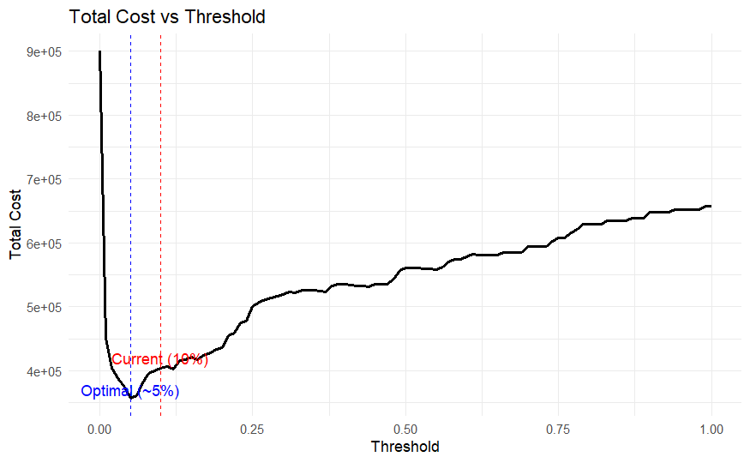
Total Cost vs Threshold: Identifying the Optimal Decision Rule
Key Insights
Total cost varies significantly with threshold choice
Minimum cost occurs at ~5% threshold
Current threshold (10%) is not cost-optimal
Notes:
I evaluated total cost across different thresholds and found that cost is minimized at approximately 5%. The current threshold of 10% is higher than optimal, which leads to missed fraud and increased total cost.

Slide 7
Business Impact: Cost Savings from Threshold Optimization
A lower threshold allows earlier detection of fraud, reducing total losses
Key Results
Current threshold (10%): $403,500
Optimal threshold (5%): $356,500
Cost Savings
$47,000 saved (per 2,000 claims)
~$23,500 saved (per 1,000 claims)
What This Means
Current threshold is too conservative
Too few claims are being investigated
High-cost fraud cases are being missed
Notes:
By lowering the threshold from 10% to 5%, total cost decreases by approximately $47,000 across 2,000 claims. This suggests that the current system is too conservative and is missing costly fraud cases. Adjusting the threshold enables more proactive fraud detection and improves overall cost efficiency.

